Slide 1


Data Management &
MeasurLink SPC Software
^{February 5th, 2015}

Slide 2
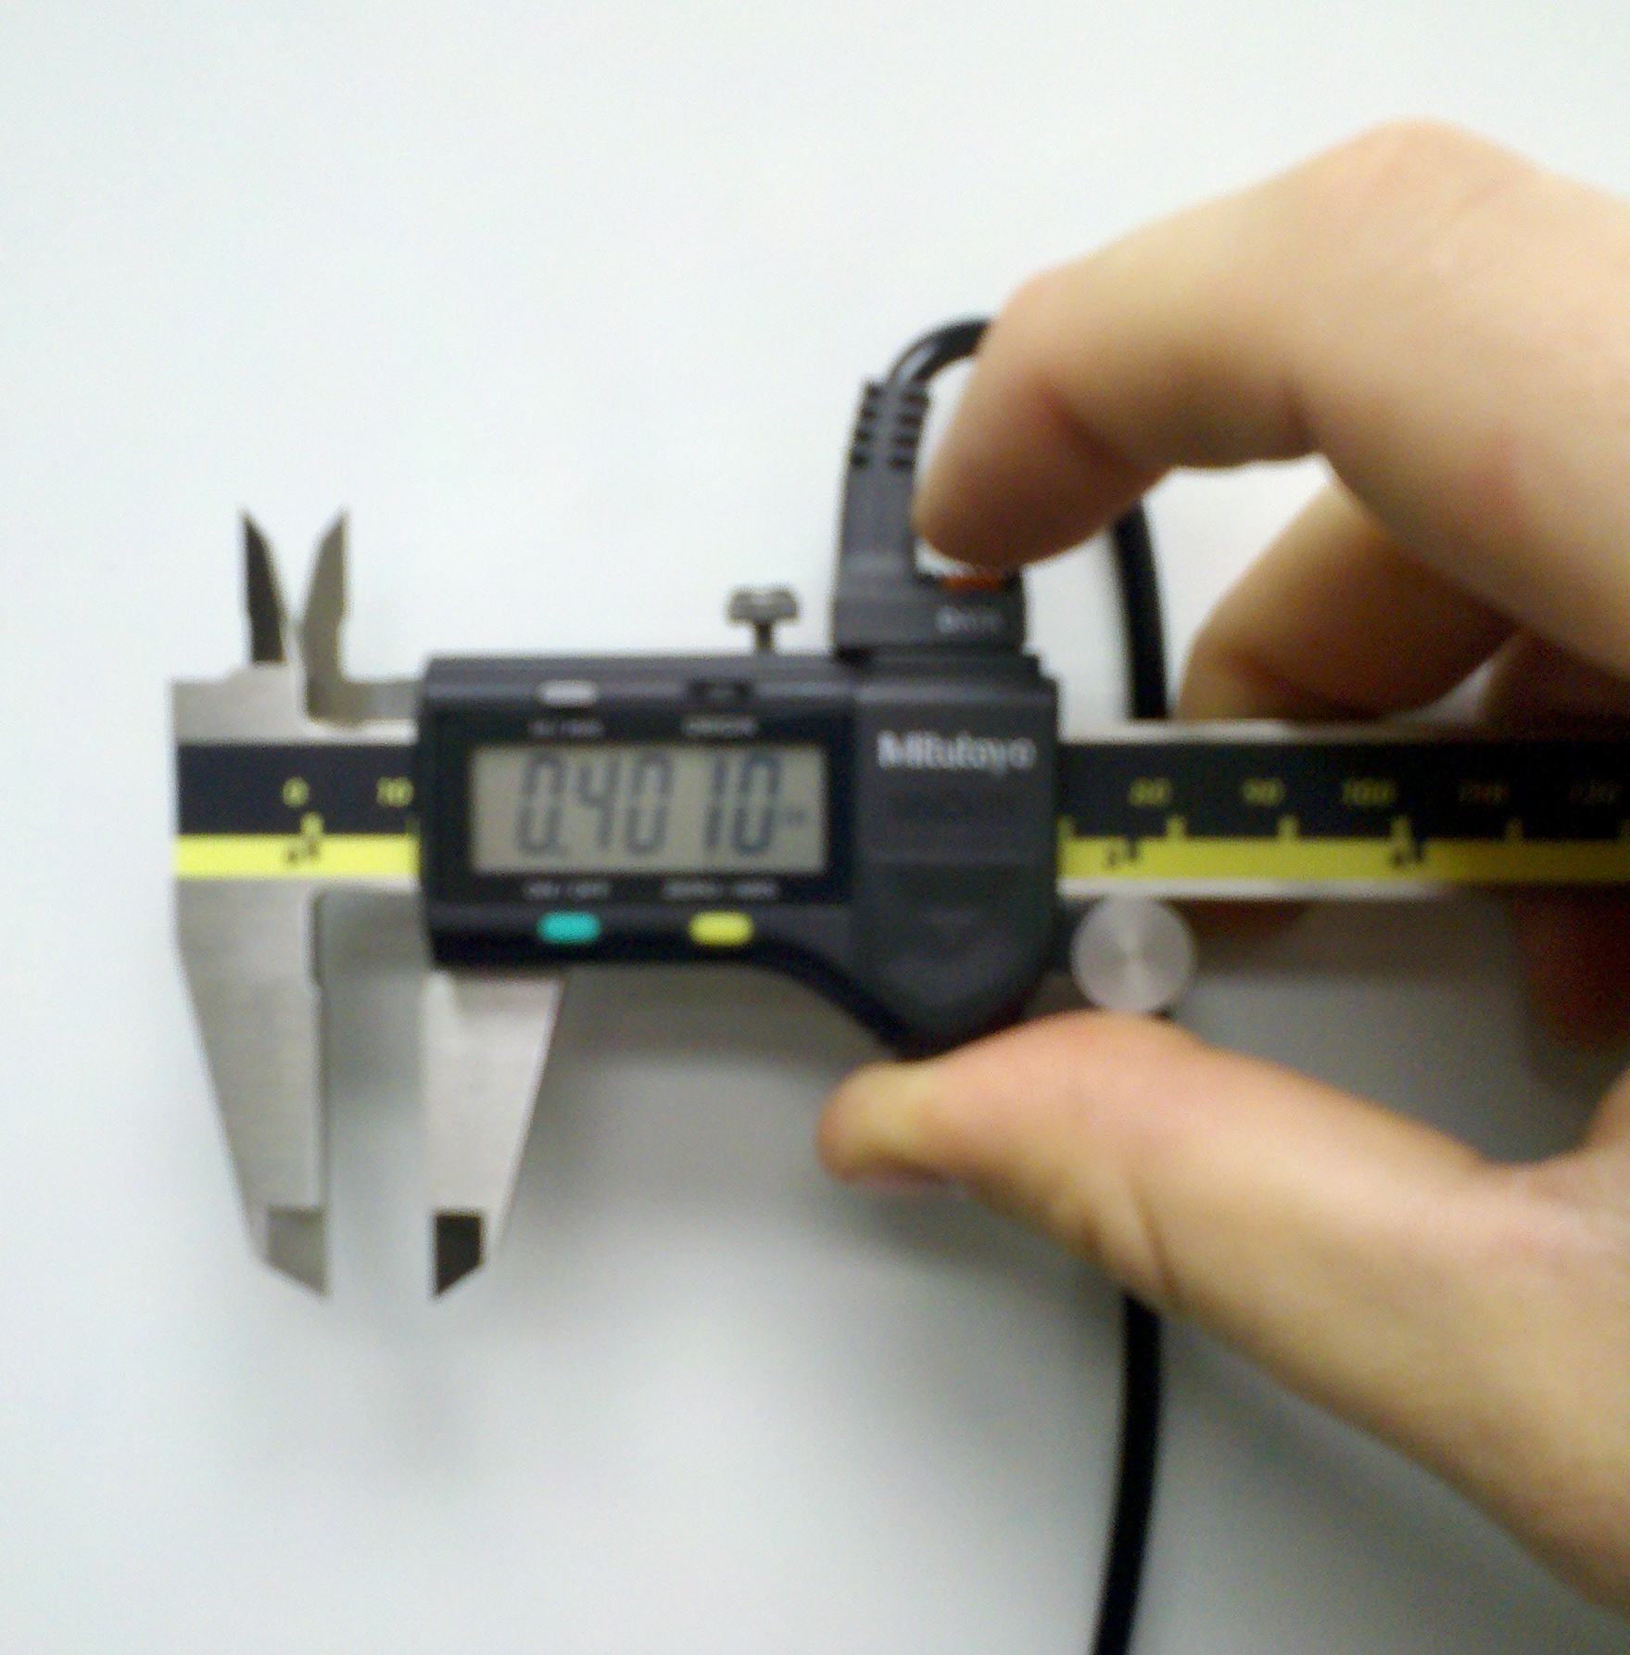
Electronic Data Collection:
Electronic data collection allows the user of the gage to send the measurement displayed on the gage directly to a computer by simply pushing a data send button:
Reduces the time required to measure and record data.
Reduces errors in data such as transposing numbers and illegible handwriting.
Increases ease of use by not having to put the gage down to pick up a pen and paper to record the data.
^{February 5th, 2015}

Slide 3
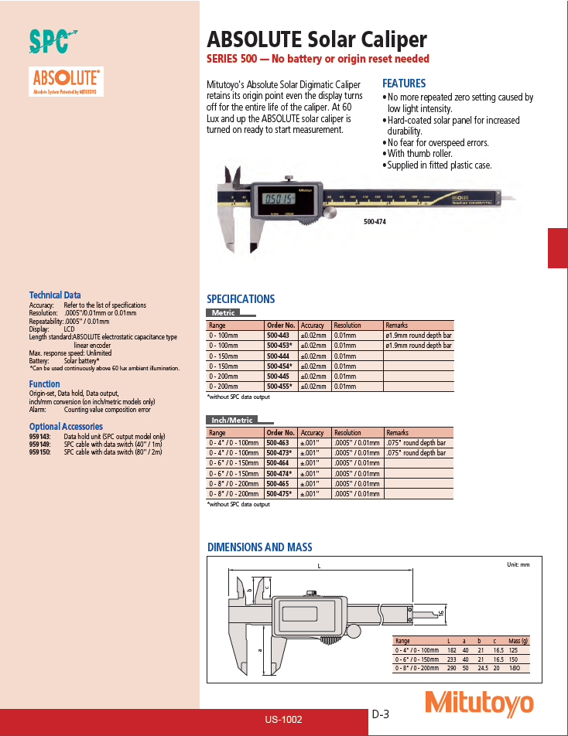
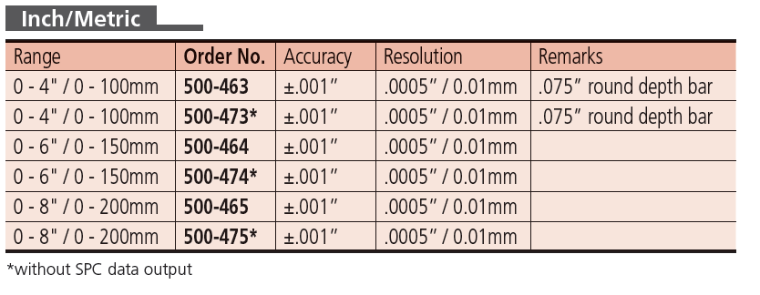
Digital Gages with SPC Data Output:
^{February 5th, 2015}

Slide 4
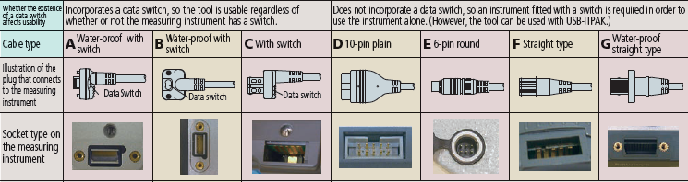
SPC Connection Types:
Many of our gages include an SPC output port. This port will vary depending upon many factors:
Model of the gage.
Age of the gage.
Is the gage Coolant Proof?
Does the gage have a Data Button?
^{February 5th, 2015}

Slide 5
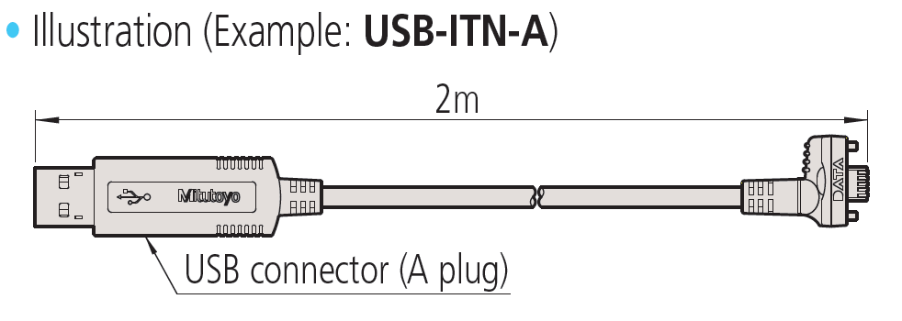
USB ITN Product Description:
The USB ITN is a device that connects a gage with SPC Output directly to a PC through a USB connection:
^{February 5th, 2015}
Features:
One piece 2 meter cable.
HID compatible (Keyboard Entry).
Supports Mitutoyo Digimatic Type A, B, C, D, E, F, G.
No software or drivers required.

Slide 6
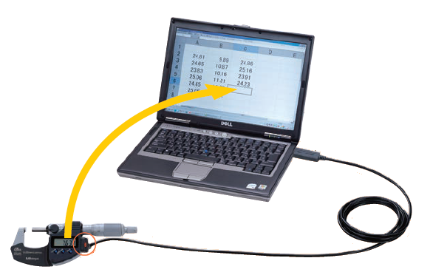
USB ITN Application Example :
The Micrometer is sending data directly to Excel each time the Data Button(circled) is pressed.
293-330 0-1” Coolant Proof Micrometer.
06ADV380B USB ITN Type B.
Laptop with Excel.

Slide 7
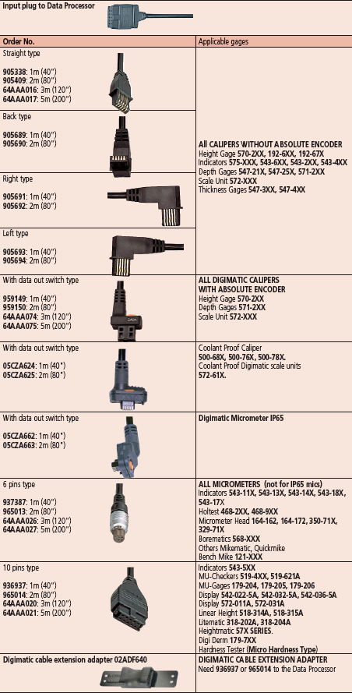
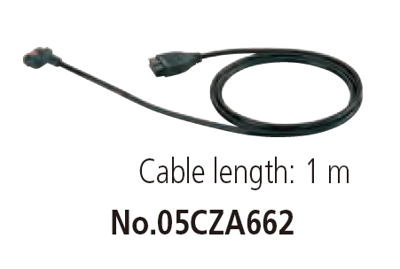
SPC Connecting Cables Product Description:
These cables are used to output measurement data from a gage with SPC output to a multiplexer or other Digimatic device:
^{February 5th, 2015}
Features:
Mitutoyo Digimatic Type A, B, C, D, E, F, G connection on one end and 10 Pin(D) connection on the other.
1 and 2 meters with 3 and 5 meters length on select models.
Requires additional equipment, cannot be used standalone.

Slide 8
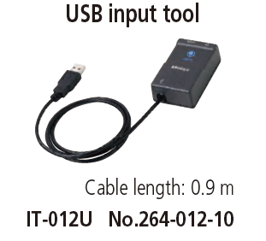
USB Input Tool Product Description:
The USB Input Tool is a device that connects a gage with SPC Output and SPC Cable directly to a PC through a USB connection:
^{February 5th, 2015}
Features:
HID compatible (Keyboard Entry).
Supports Mitutoyo Digimatic Type D.
Includes Data Button on the unit.
Supports SPC Footswitch
Requires a SPC Connecting Cable.
No software or drivers required.

Slide 9
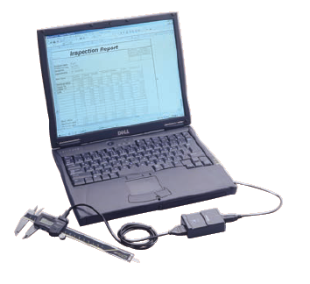
USB Input Tool Application Example :
^{February 5th, 2015}
The Caliper is sending data directly to Excel each time the Data Button on the SPC Connecting Cable or Input Tool Direct is pressed.
500-171-20 ABSOLUTE Digimatic Caliper.
959149 SPC Connection Cable Type C 1m
264-012-10 USB Input Tool
Laptop with Excel.

Slide 10
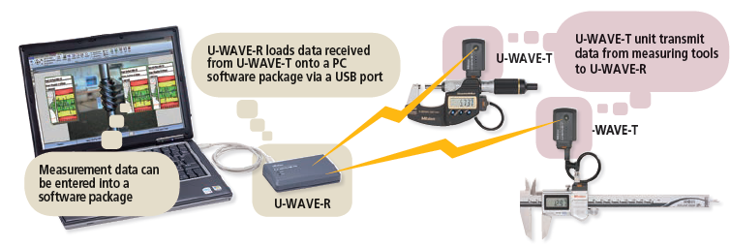
U-WAVE Product Description:
U-WAVE is a wireless system that connects a gage with SPC Output to a PC through a USB connection:
^{February 5th, 2015}
Features:
2.4 GHz wireless with a 60ft range.
HID compatible (Keyboard Entry) and Serial(VCP).
Supports Mitutoyo Digimatic Type A, B, C, D, E, F, G.
Select Cables Support SPC Footswitch.
Includes U-WAVEPAK Setup Software.

Slide 11
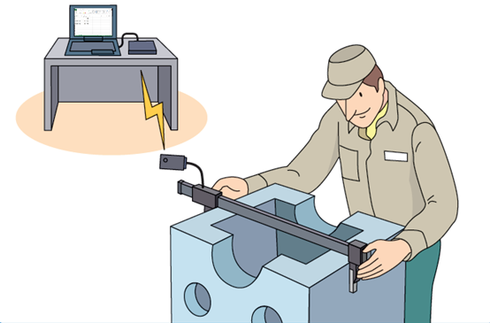
U-WAVE Application Example :
The Caliper is sending data directly to Excel each time the Data Button is pressed.
552-314-10 Digimatic Carbon Fiber Caliper
02AZD790A U-WAVE Cable Type B
02AZD730D U-WAVE-T Transmitter IP67
02AZD810D U-WAVE-R Receiver (includes U-WAVEPAK and USB Cable)
Laptop with Excel.

Slide 12
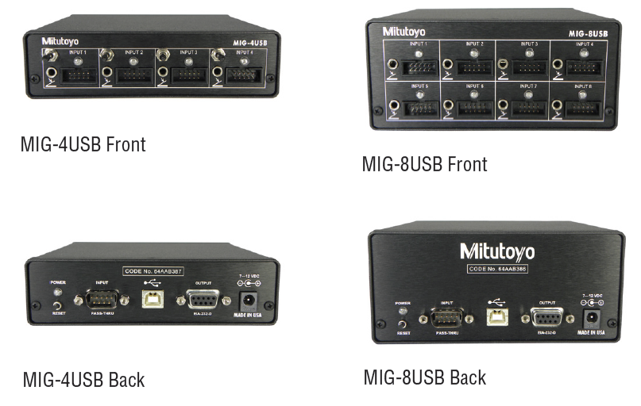
USB Multiplexer Product Description:
The USB Multiplexer is a device that connects multiple gages with SPC Output directly to a PC through a USB or RS232 connection:
Features:
HID compatible (Keyboard Entry) and Serial(VCP).
Excel Input
Firmware functions: Max, Min, TIR, Data Stream, Global Data Request, etc.
Supports Mitutoyo Digimatic Type D.
Can be connected to other MIG’s by RS232.
Includes RS-232 Cable, USB Cable, CD with Drivers and AC Adapter.

Slide 13
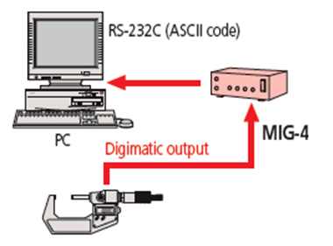
USB Multiplexer Application Example #1 :
The Micrometer is sending data directly to Excel each time the Data Button is pressed.
293-330 0-1” Coolant Proof Micrometer.
05CZA662 SPC Connecting Cable Type B 1m.
64AAB387 MIG-4USB USB Multiplexer (includes USB cable and AC adapter.)
PC with Excel.

Slide 14
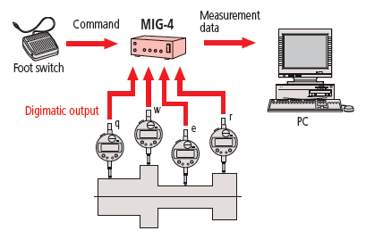
USB Multiplexer Application Example #2 :
The four Digimatic Indicators are sending TIR data directly to Excel.
293-330 Indicator(qty. 4)
05CZA662 SPC Cable Type F(qty. 4)
64AAB387 MIG-4USB USB Multiplexer
937179T SPC Footswitch
PC with Excel.
The part is loaded and the Footswitch is pressed. The part is rotated around its centerline a complete revolution and then the Footswitch is pressed again.

Slide 15
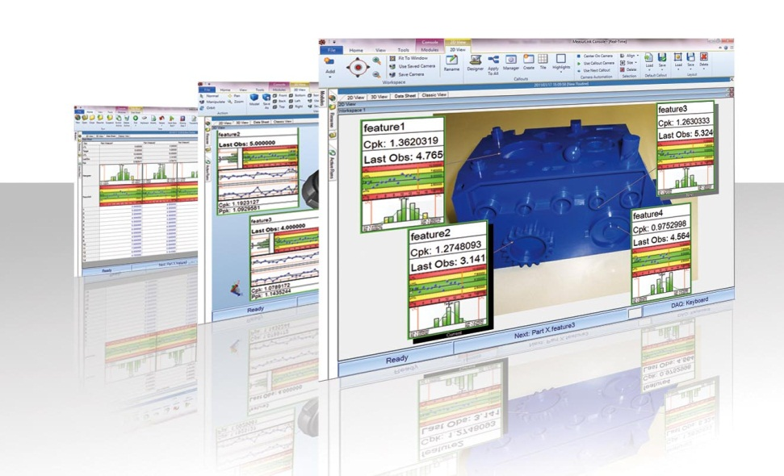
MeasurLink SPC Software
^{February 5th, 2015}

Slide 16
Benefits and Capabilities:
^{February 5th, 2015}
Data Collection
Variables/Attributes
Serial Number
Traceability
Assignable Cause/Corrective Action
Real Time Statistical Process Control
Reports
Data Export
Data Retention

Slide 17
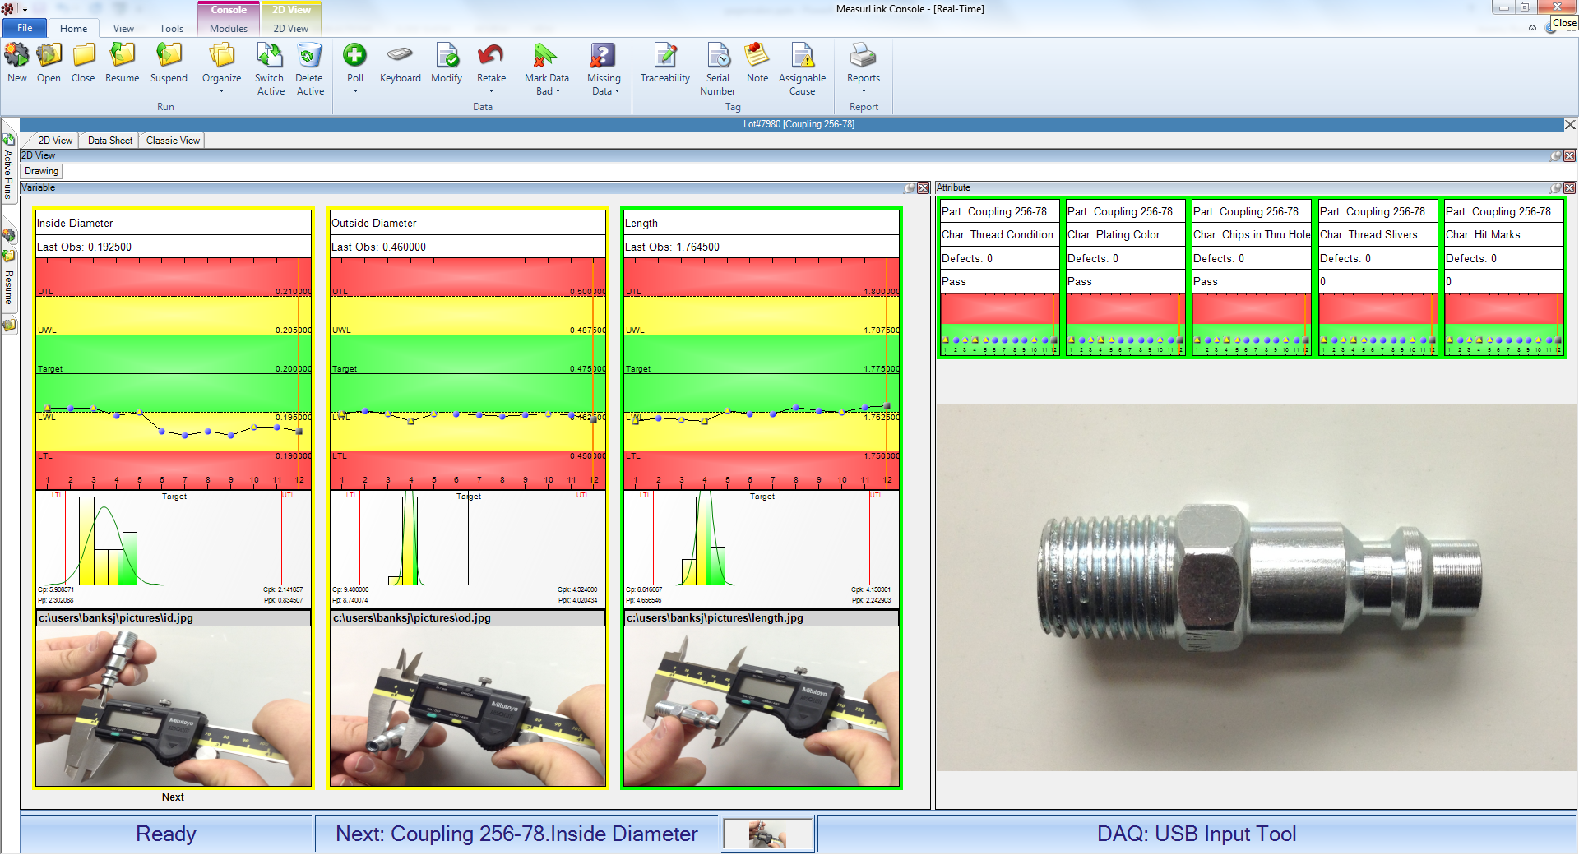
Inspection Routines:
^{February 5th, 2015}
Routines guide the operator through the measurement of the part.

Slide 18
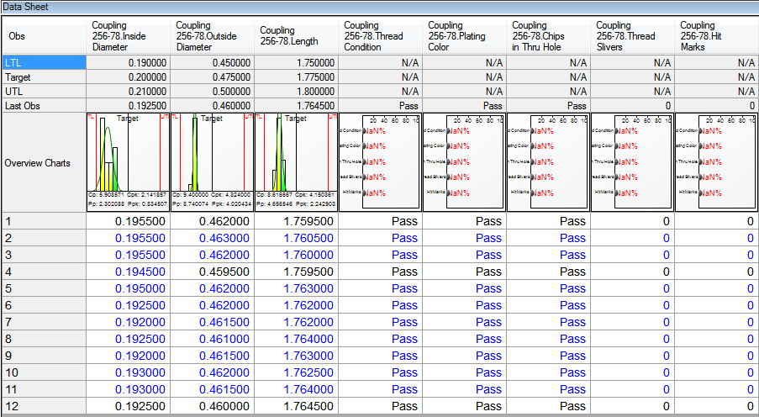
Data Retention:
^{February 5th, 2015}
The data for each part measured is retained in the database. This data can generate a report, be exported or be retrieved at a later date.

Slide 19
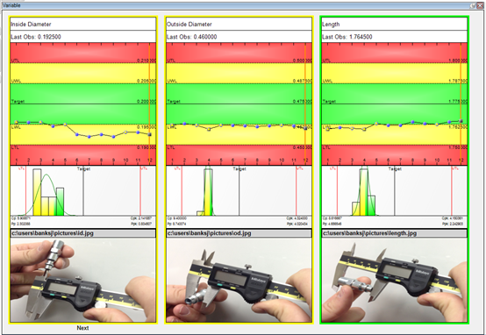
Variable Data Collection:
^{February 5th, 2015}
Variables:
Variables are usually measured with a gage and yield a number.
Diameter, length, Height, Width, etc.

Slide 20
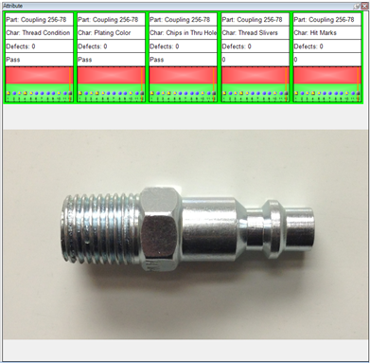
Attribute Data Collection:
^{February 5th, 2015}
Attributes:
Attributes are checked visually or with Go/No Go gages and usually result in pass or fail.
Cracks, Damaged Threads, Hit Marks, etc.

Slide 21
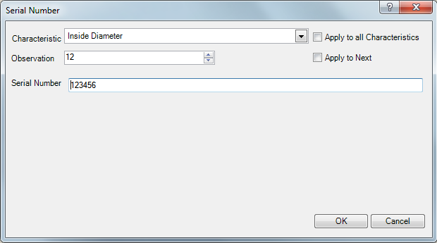
Serial Number:
^{February 5th, 2015}
Serial Number:
Serial Numbers identify each part and can be entered here.

Slide 22
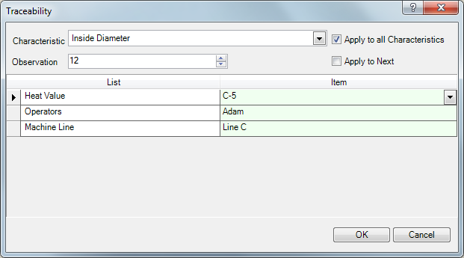
Traceability:
^{February 5th, 2015}
Traceability:
Traceability is information about a part that is important, but not a measurement.
Lot Number, Customer, Fixture, Material type, Invoice #, Order #, etc.

Slide 23
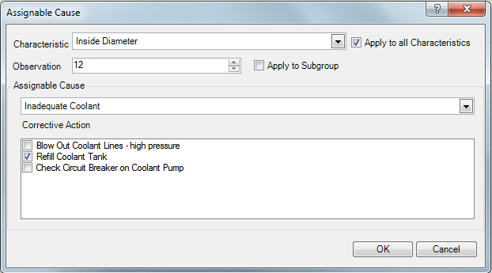
Assignable Cause/Corrective Action:
Assignable Cause:
Assignable cause is the reason for an abnormal condition.
Corrective action is the reaction to the condition.
^{February 5th, 2015}

Slide 24
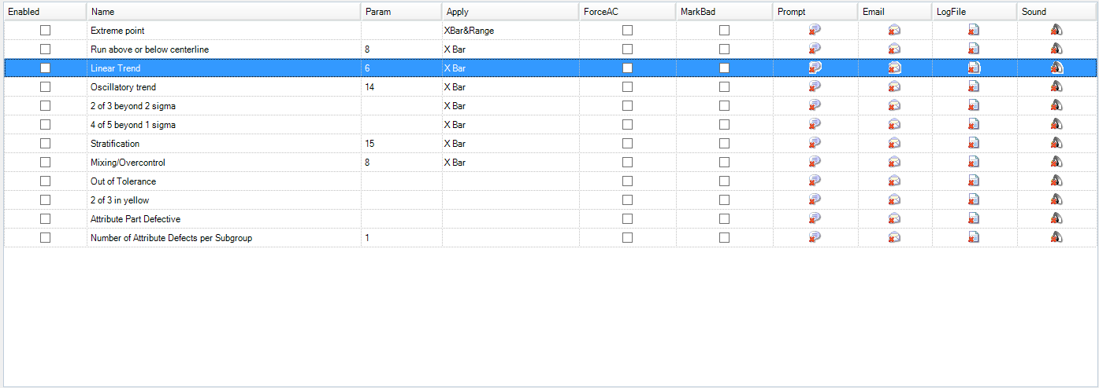
Data Tests:
Data tests are performed in real time and alerts are sent to the operators or engineers on screen or through email. Data tests can be performed in any combination and at the Routine or Characteristic level.

Slide 25
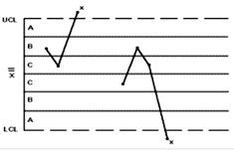
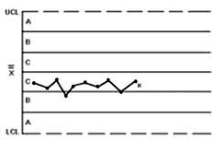
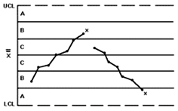
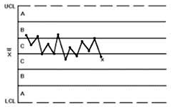
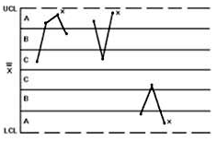
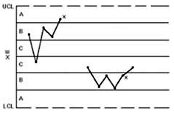
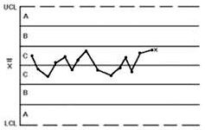
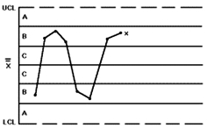
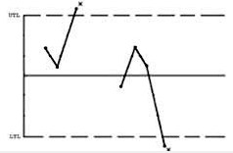
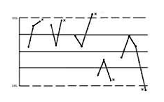
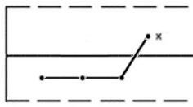

Data Tests:
Extreme Point test (Out of Control Test)
Run Above or Below Centerline
Linear Trend
Oscillatory trend
2 of 3 beyond 2 sigma
4 of 5 beyond 1 sigma
Stratification
Mixing / Overcontrol
Out of Tolerance
2 of 3 in yellow
Attribute Part Defective
Number of Attribute Defects per Subgroup

Slide 26
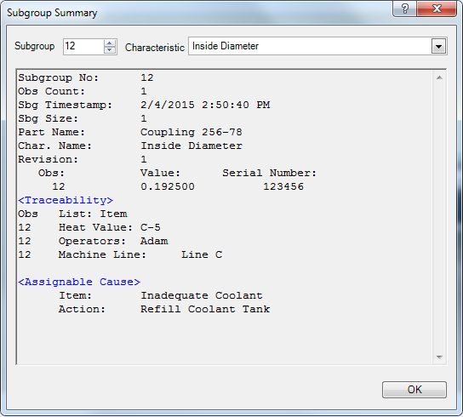
Subgroup Summary:
^{February 5th, 2015}
Summary:
All of the information about a part is recorded in the database.
The Subgroup summary shows the Measured Data, Traceability, Serial Number, Assignable Cause/Corrective Action and failed Data Tests for each part.

Slide 27
MeasurLink Modules:
There are 6 separate modules for MeasurLink:
Real-Time: Collects data from hand tools, keyboard or capital equipment
Process Analyzer: Used to remotely review, merge, and filter data and print reports.
Process Manager: Dashboard that displays the live status of all active runs.
Gage R&R: Performs reproducibility and repeatability tests for gaging according to MSA4.
Gage Management: Gage tracking and calibration software.
Report Scheduler: Supports report automation.

Slide 28
Real Time:
RT Standard collects data from the keyboard, USB or RS232 devices.
RT Professional collects data from the above and capital equipment.(DDE & Text)
RT Professional 3d collects data from the above while displaying a 3D model.
Each inspection station would require a copy of Real-Time to collect data.

Slide 29
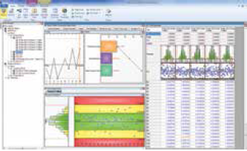
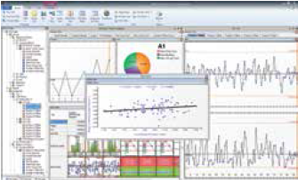
Process Analyzer:
Allows users remotely access data measured by any station of Real-Time.
Users can Merge, Filter and review data and print reports.
Engineers and supervisors would need a copy of Process Analyzer.

Slide 30
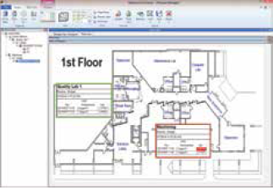
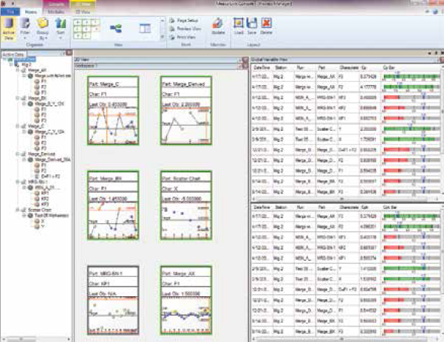
Process Manager:
Allows users remotely view the live status of active runs as a Dashboard.
Many users display on large monitors in the shop and/or lab.

Slide 31
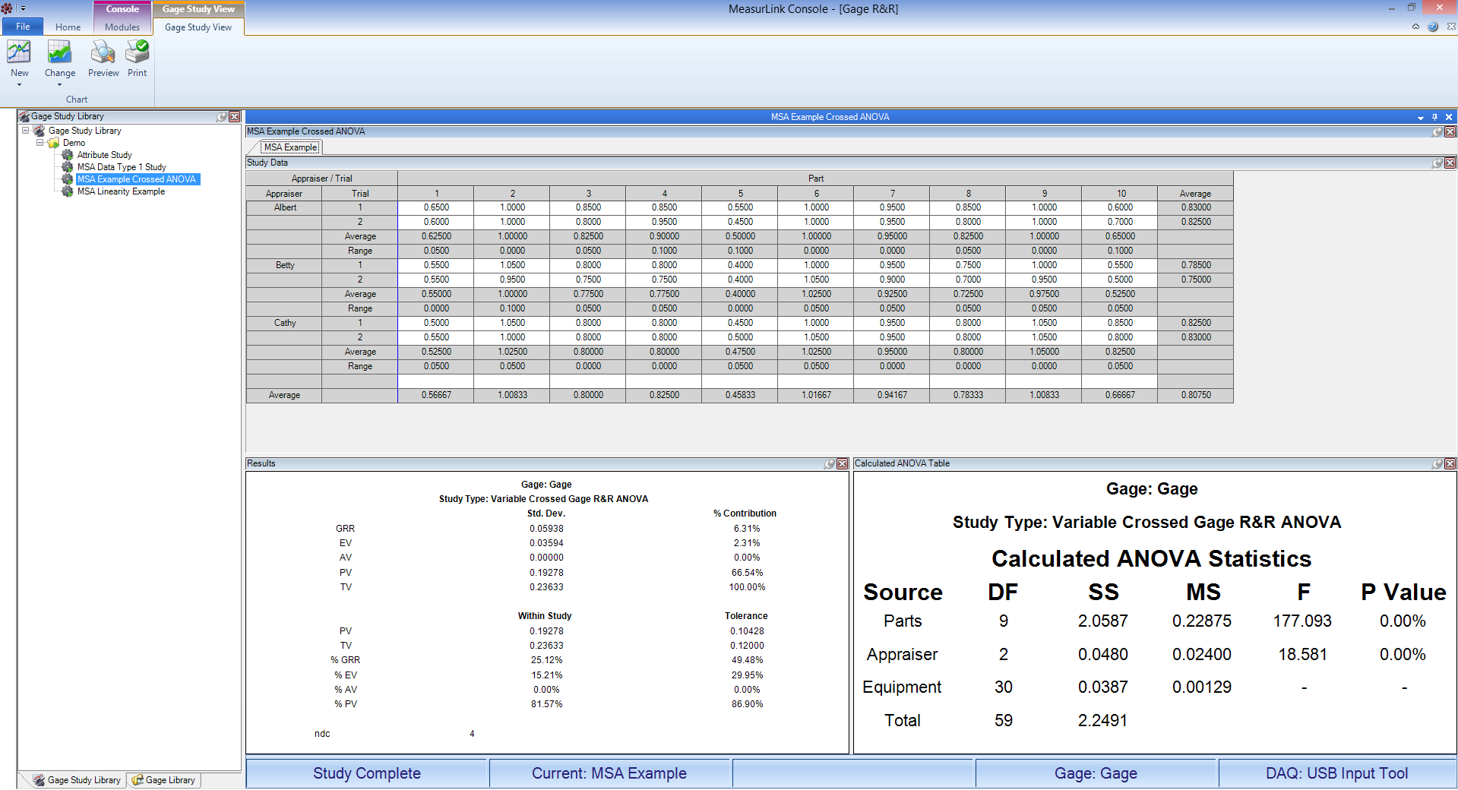
Gage R&R:
MeasurLink Gage R&R uses calculation methods based on AIAG's Measurement Systems Analysis, Fourth Edition (MSA4).
The following study types are supported:
Location
• Bias
• Linearity
Reproducibility
• Type I
• Variable Range Method
Repeatability & Reproducibility
• Crossed ANOVA
• Crossed Average & Range
• Nested ANOVA
• Nested Average & Range
Stability
• Stability

Slide 32
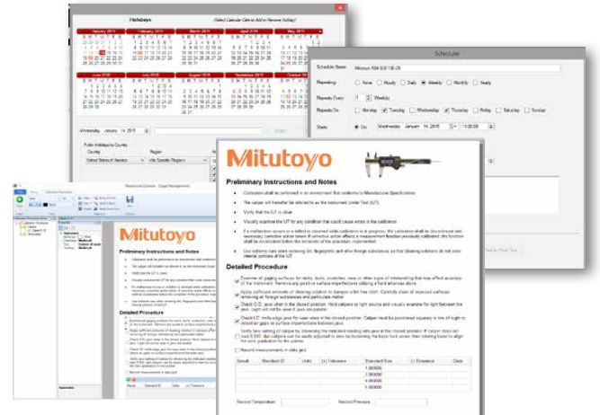
Gage Management:
• Gage inventory management
• Calibration history
• Calibration procedures
• Assessment and reporting
• Gage vendor management
• Gage location management
• GR&R history

Slide 33
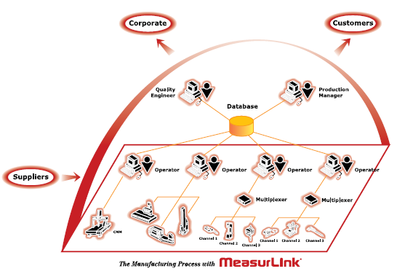
Packages:
The MeasurLink suite is best acquired as a Workgroup or Site License. These packages are a mix and match bundle of any module. Workgroups are 5, 10 and 15 seats. A Site License is 30 or more seats of MeasurLink. The package can be any combination of Real-Time, Process Analyzer, Process Manager, Report Scheduler, Gage R&R and/or Gage Management modules. All of the stations in the installation store their data in a SQL Database located on the user’s network.
• Better unit cost
• Mix and match desired modules
• Site Licenses can be shared among multiple facilities.
• Security Center can manage users access with each module.
• Support Center allows users to manage the suite through the network, eliminating interruption in data collection.

Slide 34

Floating Licenses:
Users who want to use MeasurLink in a terminal server environment or want to have a number of concurrent users should consider the Floating License upgrade option. This upgrade is available in packs of 5, 10, 15 and 30. This upgrade includes a licensing sever, DeployLX version 5, that manages the number of seats available.
This type of installation is common in modern IT infrastructure. Thin-Client hardware or traditional PCs can utilize this option. A user could choose to upgrade a portion of or their entire number of seats to the Floating License upgrade option.
• Easier maintenance of installations
• Most flexible use of modules
• Cost effective way to include more users without purchasing additional seats.
• Can be added to an existing installation or integrated during the initial installation.

Slide 35
Thank You

