Slide 1
SPC in 3 Steps
Robert Fruit
American Society of Quality
Certified Six Sigma Black Belt
Certified Quality Engineer
Mitutoyo America Corp.

Slide 2
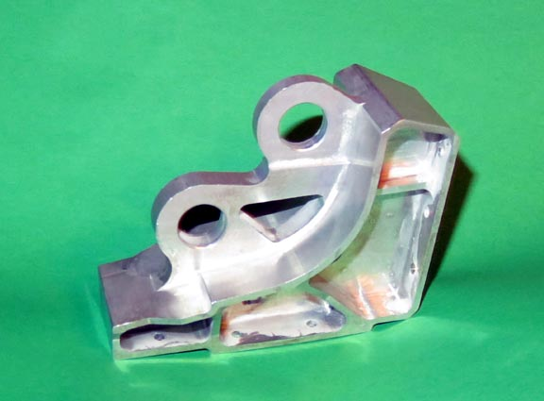
SPC in 3 Steps
Step 1 – Collect Data and Charting
Step 2 – Histogram and Statistics
Step 3 – Capability Indexes and Maintaining Process

Slide 3
Define SPC
SPC – Statistical Process Control
  Statistics – mathematical tools that summarize current behavior that are expressed in numeric terms
  Process – any series of steps that takes raw material and transforms it into a product or service customers are willing to pay for
  Control – the expression of statistical tools to enhance the monitoring of a process
For manufacturing SPC tools includes:
  Statistics – average, standard deviation, Correlation Coefficients, …
  Charts – Run Charts, Control Charts, Histograms, Scatter Charts, …
  Control – Control Limits on Average and Range, Capability Indexes, Assignable Causes, Corrective Actions, …

Slide 4
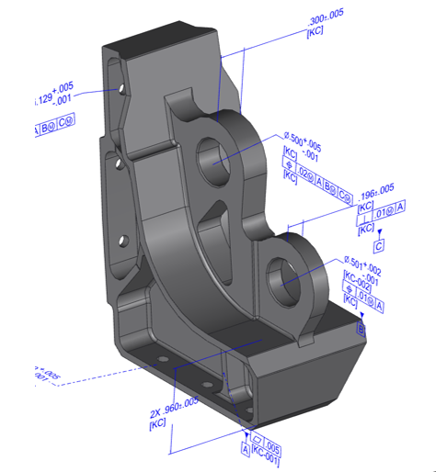
Steps leading up to Manufacturing
Design engineer builds part in CAD system
Quality Control engineer identifies locations critical to quality
Machining is set up to manufacture the part
PPAP study (Production Part Approval Process) is conducted to qualify the manufacturing process

Slide 5
Step 1 – Collect Data and Charting
Precontrol Chart
X-Bar and R Chart

Slide 6
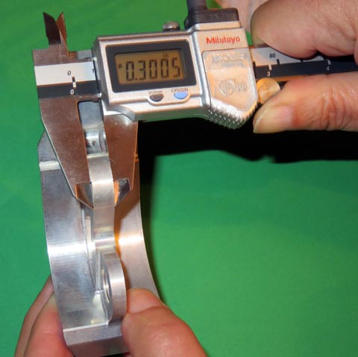
Manufacture the Part and check Critical to Quality measurements
Manufacture the part
Measure at points critical to quality
Record and chart data immediately
Record Assignable Causes and Corrective Actions when problems arise

Slide 7
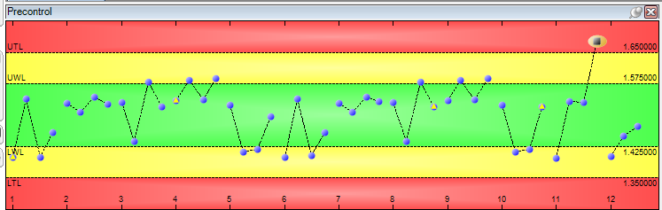
Where Does SPC Start?
SPC starts with collecting data on features critical to quality at the point of manufacture
Precontrol Chart is a good chart for operators
  Easy to see the data
  Easy to interpret if data is in tolerance
  Not a formal SPC chart but it is still good to use at the point of data collection
Use systems that capture data directly from gaging system
  Eliminates the error-prone nature of hand recorded data
  Get graphic results immediately at point of manufacture!

Slide 8
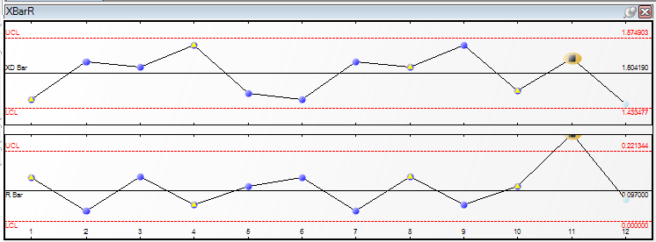
X-Bar & R Chart
X-Bar & R chart is two charts
  X-Bar chart – subgroup average
    On average, are the parts the same size over time
  R chart – subgroup Range
    Is the manufacturing process consistent over time?
    Subgroup 11 is not consistent
    Validates that a process is stable over time

Slide 9
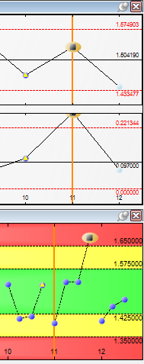
Look at Subgroup 11
Precontrol chart showed a problem at time of manufacture
Operator recorded assignable cause
  Sudden drop in air pressure
Operator recorded corrective action
  Check air gage
  Reported problem to maintenance
  Maintenance found hole in air line
SPC system provides records of when things are going right and when things are going wrong

Slide 10
Control Limits Are Not Tolerance Limits
Tolerance Limits (on Precontrol)
  Upper Tolerance Limit 1.65
  Lower Tolerance Limit 1.35
Control Limits (on X-Bar & R chart)
  X-Bar Upper Control Limit 1.574903
  X-Bar Lower Control Limit 1.433477
  R Upper Control Limit 0.221344
  R Lower Control Limit 0.000000
Control Limits are based on statistics, average and standard deviation
X-Bar Chart – On average, is the part the same size?
R Chart – Is the manufacturing process stable over time?

Slide 11
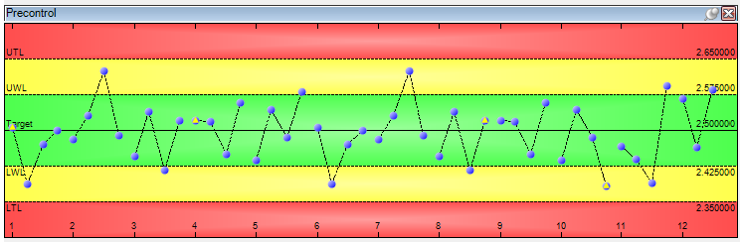
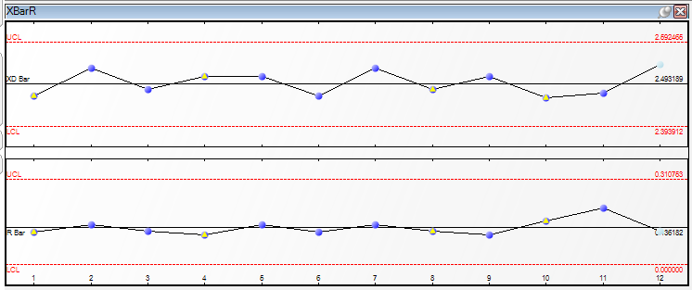
Quality Control at time of Manufacture
Quality Control is interested in:
  Precontrol Chart – Is manufacturing creating in-tolerance parts?
  X-Bar & R Chart – Is manufacturing maintaining a consistent average and a stable process?

Slide 12
Stable Process
Manufacturing must have a stable process for the remainder of this discussion
  X-Bar Chart – all points are “in control”
  R Chart – all points are “in control”
Statistical predictions can only be made on stable processes

Slide 13
Step 2 – Histogram and Statistics
Histogram Chart
Statistics

Slide 14
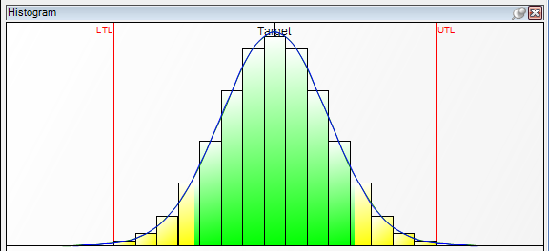
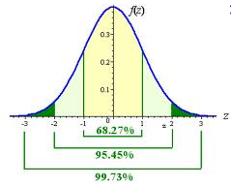
Histogram Charts
Classic Histogram
Histogram is a probability density chart
Normal Probability histogram measures probable distribution of manufacture parts relative to target and tolerance
http://www.intmath.com/counting-probability/14-normal-probability-distribution.php

Slide 15
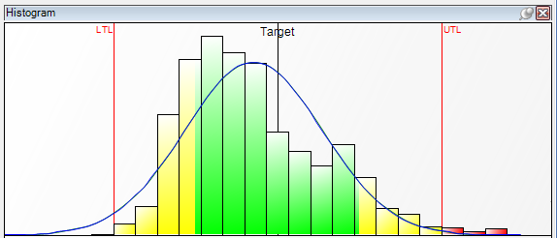
What a Quality Engineer looks for: Histogram Centering
Look to peak area of Histogram compared to tolerance target area
Normal probability curve helps in judging histogram
  Is peak area of histogram similar to peak area of normal probability
  How close to target is the peak area

Slide 16
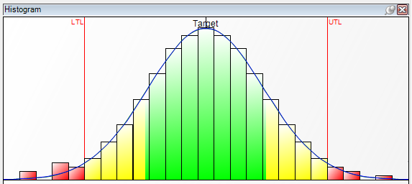
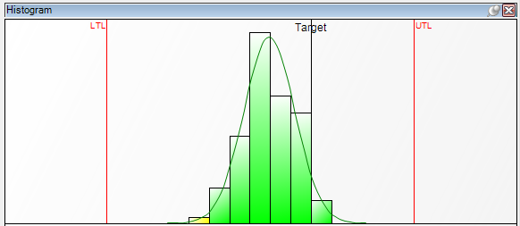
What a Quality Engineer looks for: Histogram Spread
Compare width of histogram to tolerance width
Outside of tolerance are bad parts

Slide 17
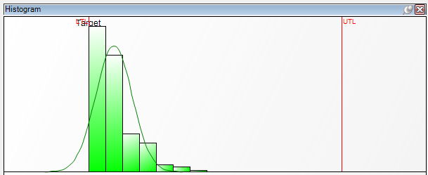
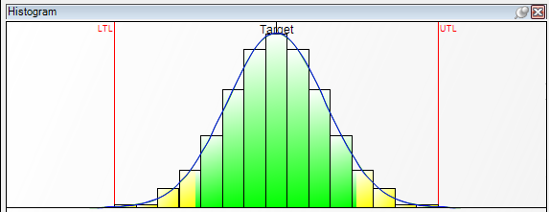
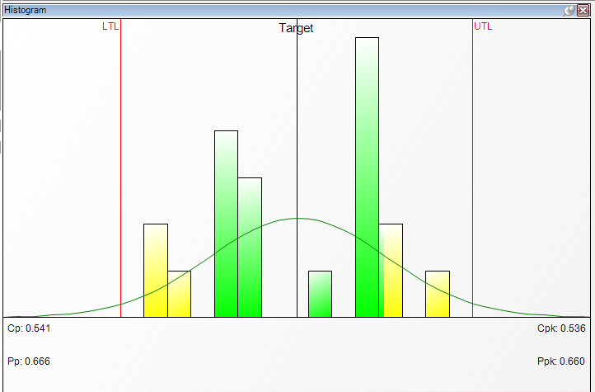
Histogram is a Broad Picture of Manufacturing Process
Histogram is the best average image of manufacturing results compared to design requirements
What do these histograms tell you about the data?

Slide 18
Statistics show the numbers
Statistics
  Tolerance
    High Tolerance 1.65
    Target 1.50
    Low Tolerance 1.35
  Average
    Average 1.50419
    Average – Tolerance Target 0.00419
  Standard Deviation
    Standard Deviation 0.023571
    Average + 3 * Standard Deviation 1.574903
    Average – 3 * Standard Deviation 1.433470
  How easy is it for you to interpret these numeric results?

Slide 19
Do a comparison
Tolerance
  UTL 1.65
  LTL 1.35
  Target 1.50
Control
  UCL 1.574903
  LCL 1.433470
  Average 1.50419
  Target – Average =
  0.00419
  Std. Dev. 0.02357
Control Limits are inside tolerance range – good
  Control Limits are 3 std. dev. either side of Average
  This encapsulates average and standard deviation
Average and target have close proximity – good
  Target – Average is small relative to std. dev.

Slide 20
Step 3 – Capability Indexes and Maintaining Process
Capability of Process Cp
Capability of Process adjusted for Average offset from center of Tolerance Range Cpk

Slide 21
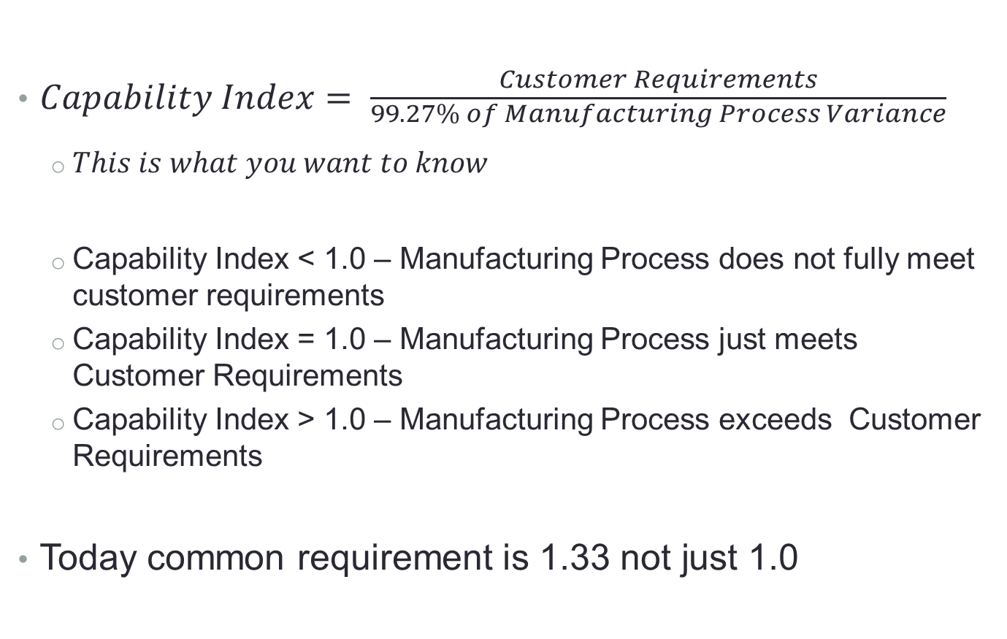
Principle Meaning of Calculating Capability Indexes
$Capability Index= \frac{Customer Requirements}{\begin{aligned}99.27\% of Manufacturing Process Variance \\ \end{aligned}}$
  $This is what you want to know$
  Capability Index < 1.0 – Manufacturing Process does not fully meet customer requirements
  Capability Index = 1.0 – Manufacturing Process just meets Customer Requirements
  Capability Index > 1.0 – Manufacturing Process exceeds Customer Requirements
Today common requirement is 1.33 not just 1.0

Slide 22
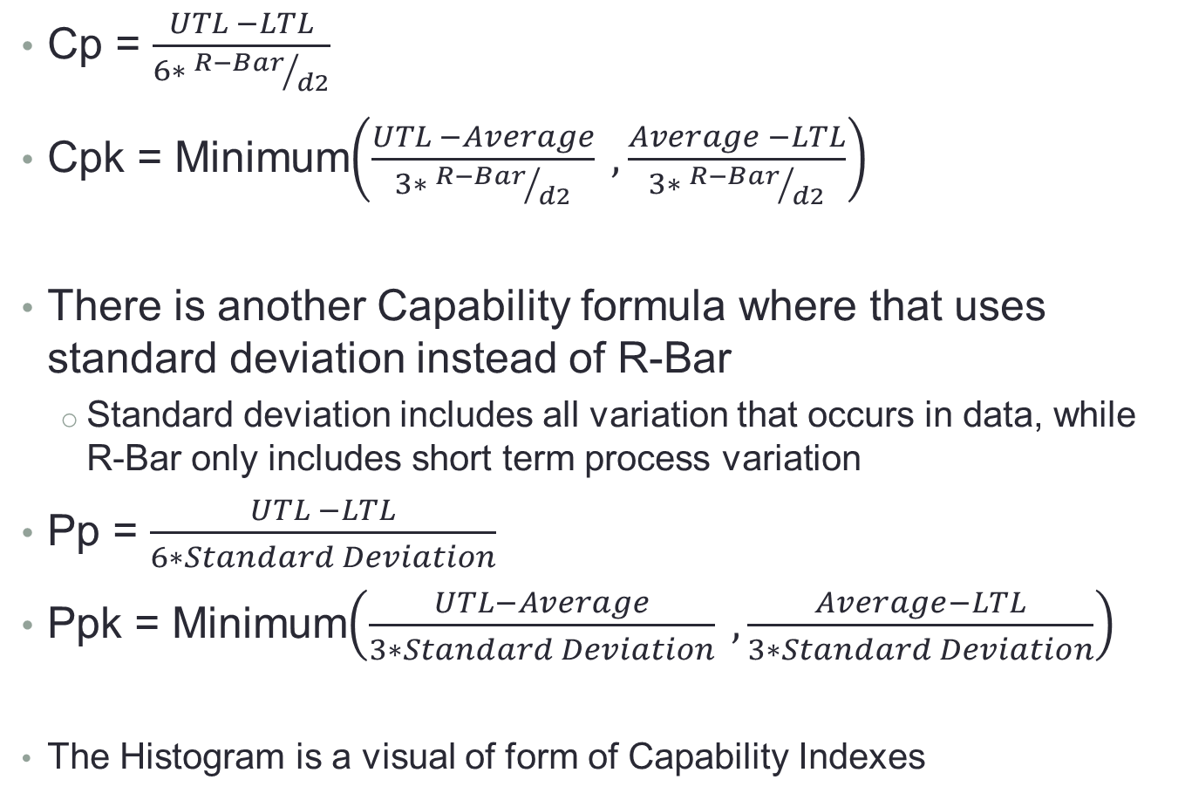
Capability Index Formula
Cp = $\frac{UTL −LTL}{6∗ {R−Bar}/{d2}}$
Cpk = Minimum$\left(\frac{UTL −Average}{3∗ {R−Bar}/{d2}} , \frac{Average −LTL}{3∗ {R−Bar}/{d2}}\right)$
There is another Capability formula where that uses standard deviation instead of R-Bar
  Standard deviation includes all variation that occurs in data, while R-Bar only includes short term process variation
Pp = $\frac{UTL −LTL}{6∗Standard Deviation}$
Ppk = Minimum$\left(\frac{UTL−Average}{3∗Standard Deviation} , \frac{Average−LTL}{3∗Standard Deviation}\right)$
  The Histogram is a visual of form of Capability Indexes

Slide 23
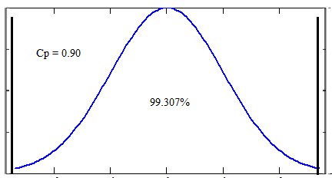
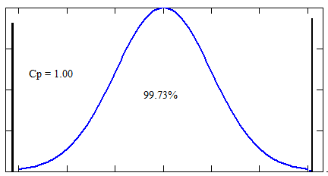
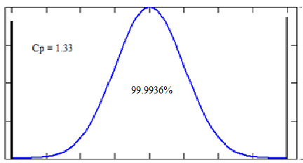
Cp
Here is the graphical and mathematical meaning of Cp
  Notice how the normal curve narrows so more of the curve is between the tolerance limits as Cp gets larger
  Area of curve outside of area shown is probability of defective parts
Cp = 0.90
  99.307% of curve within tolerance limits
  Defect – 6,933.9 DPM
Cp = 1.00
  99.73% of curve within tolerance limits
  Defect – 2,700.0 DPM
Cp = 1.33
  99.9934% of curve within tolerance limits
  Defect – 66.1 DPM
DPM = Defects per Million

Slide 24
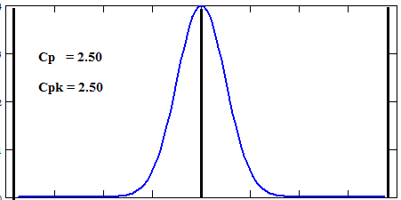
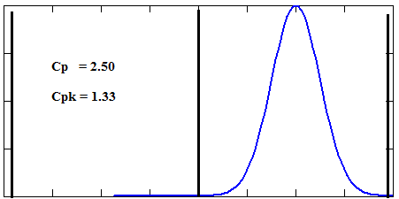
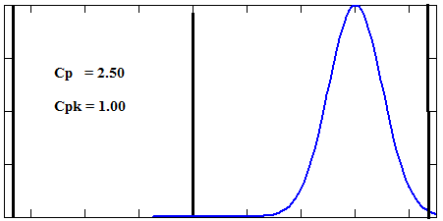
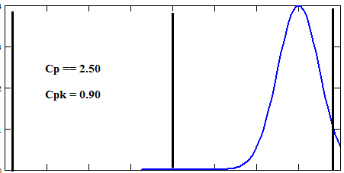
Cpk off target effect
As process gets further from target, Cpk gets smaller

Slide 25
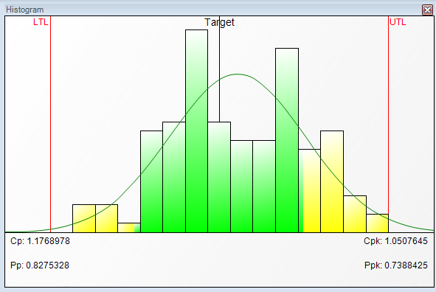
Capability Index
The Capability Index incorporates everything you have seen up to this point in a single number
That single number can be interpreted to mean defects per million.
Capability Index is the one thing that you can look at to quickly interpret if the manufacturing process is achieving the desired level of performance
  This is only true when the Control Chart is “In Control” and the histogram has normal probability like shape
Cp = 1.1768978
Cpk = 1.0507645
  This Cpk predicts 1,800
  defects per million parts
  Think of defects per million in terms of delivering mail – How many letters
  to the wrong mail box are allowed?

Slide 26
Capability Index Relationship To Defects Per Million
  Cpk = 0.70 DPM = 35,728.8
  Cpk = 0.80 DPM = 16,395.1
  Cpk = 0.90 DPM = 6,933.9
  Cpk = 1.00 DPM = 2,700.0
  Cpk = 1.10 DPM = 966.8
  Cpk = 1.20 DPM = 318.2
  Cpk = 1.33 DPM = 66.1 typical manufacturing requirement
  Cpk = 1.50 DPM = 6.8 this is often known as 6 sigma
  Why Cpk and not Cp
    Cp is the best the current process could do if all parameters are at their best performance level
    Cpk incorporates the shift away from centered target and better represents actual performance
    What Cpk do you want the U.S. postal system to perform at?

Slide 27
The Job of a Quality Engineer
At point of manufacturing a Quality Engineer wants
  Parts in tolerance
  Precontrol Chart in tolerance and Control Charts in control
  Process is stable – this is especially important because Cpk is not valid if control charts do not show the process is stable
Quality Engineer managing a shop floor
  Use histogram to visually check process fit to tolerance condition
  Use numeric statistics to check that visual (Histogram) interpretation of manufacturing process is correct
Quality Engineer overall responsibility
  Current manufacturing is repeating historical behavior of process – established by control charts and histogram
  Capability shows the current behavior of manufacturing process and for stable processes it predicts what it will be in the future

Slide 28
Thank you for letting me share this with you today
Questions?
I have prepared 2 questions based on things I am frequently asked

Slide 29
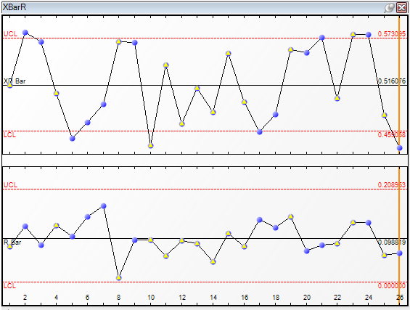
How does SPC improve a process?
Below is an example of inspecting data
How would you improve this process?
Most people would say it is good enough – no out of tolerance parts (no red)

Slide 30
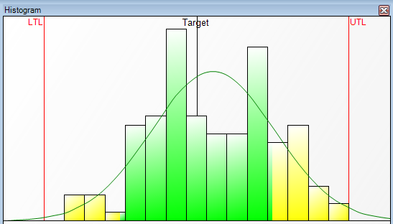
Histogram – appears to have 2 peaks of data
At first glance histogram appears to be OK, no out of tolerance parts
2 peak suggest a deeper look
Data source – 2 machining centers feeding 1 inspection station
This could instead be injection plastics with a 2 cavity form
Subgroup size = 5

Slide 31
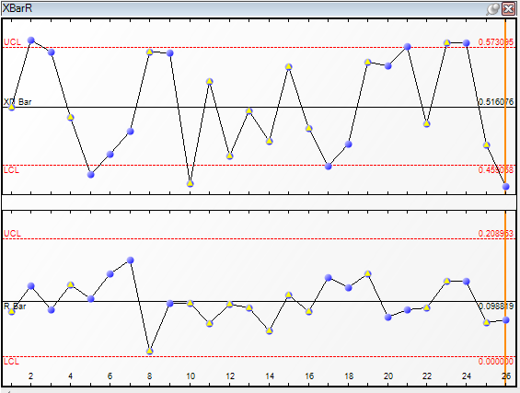
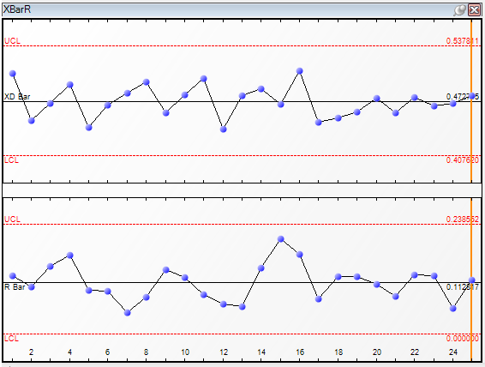
X-Bar & R – what to notice
Start in R chart
  Both Histogram Data and Better Behaved Data show good R charts
  Within subgroup range is well behaved
X-Bar and R chart
  Histogram Data definitely not well behaved – wild swings in X data
  Look for outside influence causing wide swings in X-Bar chart
  Remember that data comes from 2 machining centers
Histogram Data
Better behaved Data

Slide 32
X-Bar & R – Importance of Traceability
Notice some of the data points have a yellow triangle
This shows a traceability change
This data is tagged with Machine ID A or B
This provides additional information to help identify sources of variation

Slide 33
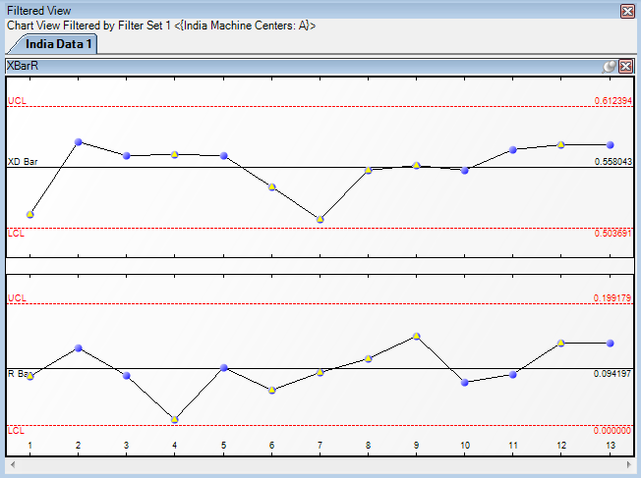
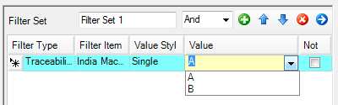
Traceability
Data filtered for Machine ID A
This is a well behaved X-Bar & R chart
Machine ID identified outside influence

Slide 34
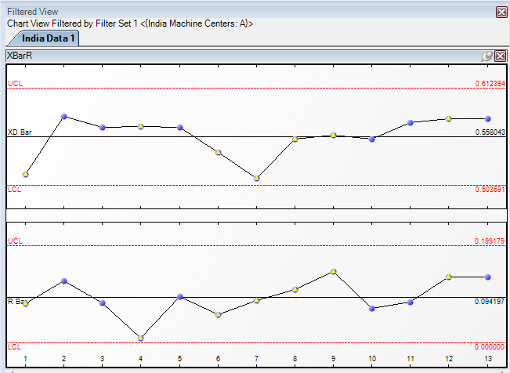
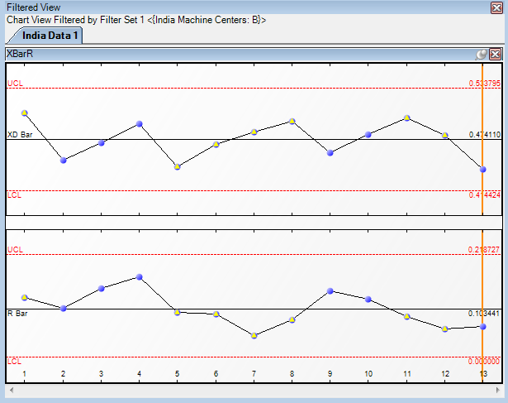
Traceability
Target 0.500
Both Machines A and B show they are off target and need adjusting to target
Machine ID A
Machine ID B

Slide 35
Your turn for questions
Questions?

Slide 36
What is the Perfect Subgroup Size?
There is no perfect subgroup size
Walter Shewhart developed X-Bar&R charting in the 1920 and established the subgroup principles:
  Within subgroup represents a short period of time so that it only includes natural machine variation. Natural machine variation means vibration and tool shift not influenced by outside events, like temperature due to sun light, low electrical power early in the morning due to all companies powering up, etc.
  Individual subgroup over time represent the long term history of the machining system, the shifts between subgroup do pickup the environmental effect not seen within subgroups.
  This makes an X-Bar & R chart a laboratory test of the manufacturing process to keep the long term variation in a machine as close to the short term variation as possible.

Slide 37
What is the Perfect Subgroup Size?
General Rules:
CMM \ Vision \ Form are almost always subgroup size = 1
  Parts coming to these measuring systems are far removed from time ordered manufacturing
Incoming inspection is almost always subgroup size = 1
  Parts in incoming inspection have lost all time order reference
Typically, subgroup sizes = 1, 2, 3, 4, or 5
When selecting parts from a process, time available to measure the parts determines subgroup size
  In general, subgroup size = 3 is better than subgroup size = 2
  Subgroup size = 4, is not as great an improvement over subgroup size =3 as subgroup size = 3 is over subgroup size = 2
When in doubt a subgroup size = 1 is recommended

Slide 38
Really it is time for your questions
Questions?

